Slide 1
Tkinter GUIs
Computer Science and Software Engineering
© 2014 Project Lead The Way, Inc.

Slide 2
GUI Toolkits
Often implemented in several languages
Some commonly used toolkits:
wx, Tk, Qt
Toolkits offer widgets and event handlers for you to subclass*
* More on what subclassing is later
Notes:
Tkinter is a GUI toolkit. There are lots of toolkits out there. The toolkits have basic similarities. Tk is implemented in several languages, including Java and C++, and it is the standard toolkit in Python.

Slide 3
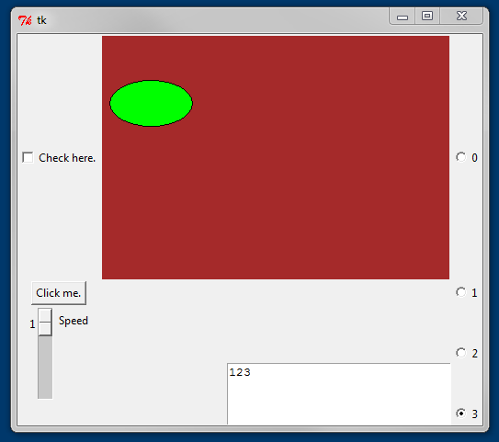
Widgets
Toolkits offer widgets and event handlers
Notes:
This window shows many of Tkinter’s widget classes. The first column contains a Checkbox, a Button, and a Scale for sliding. The second column contains a Canvas for drawing on and a Text window for displaying and editing text. The rightmost column contains four Radio buttons (named after the pop-out buttons that were used for years to select preset radio stations in automobiles). Standard UI design makes users expect that round, small buttons like these come in a set and that only one will be selectable at a time from the group.

Slide 4

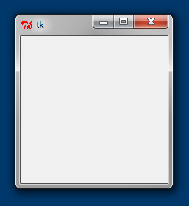
The Simplest Tkinter Program
Notes:
One class in the Tkinter library is the Tk(). You should only instantiate one of these in your program. It will be the parent (or grandparent, or great grand parent, or …) of all other windows and widgets you create. Parent?! That will explain why we called it root.

Slide 5
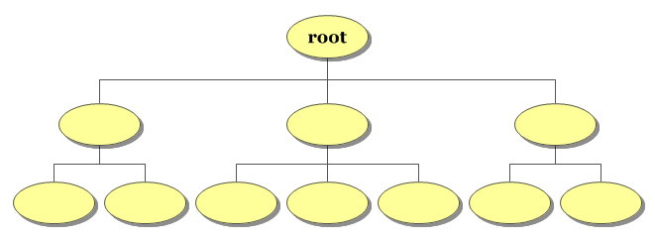
CS Concept: Root in a Tree
Tree: Each node has one parent
Root of a Tree: All nodes in the tree descend from the root
Not all trees have roots
Notes:
A tree is a structure where every node has exactly one parent. Only a root node, which is at the top of the tree, has no parent. If some nodes have two parents, like human family trees, we would have to call it a graph, a broader category than “tree”. A tree is a specific type of data structure in computer science. The root Tk() instance you create is the root in your program of all the other windows and widgets the application creates.

Slide 6

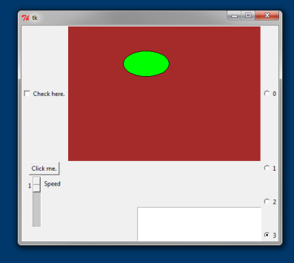
The Widgets: Canvas
Has methods for drawing items on the canvas
Items can be changed
Notes:
You can draw on a Canvas object. Line 4 instantiates a Canvas. Notice the constructor wants to know the widget’s parent in the first argument.
Line 5 places the Canvas in its parent, the root window. We will use the grid() method for every widget. More on that later.
Line 6 draws an item on the Canvas. The items are objects, too, not just pixel manipulations like in the last lesson. The command in the lower right could be used to move the item.
Notice that the method is being called on the Canvas, not on the item. The Canvas object keeps data relating to its items. You can see the data or change it, but you have to ask the Canvas object to do that for you. This is called data hiding or encapsulation. Concerns with details about how the Canvas code is handling the items is kept separate, encapsulated in the Canvas code.

Slide 7
grid() the Geometry Manager
Columns
0 1 2
0
1
2
3
Rows
Notes:
The grid method lets you specify the row and column for each widget.
The Canvas was placed in row=0, column=1.
The Text widget is spanning two rows, starting in row 2. It is also in the southeast corner of its cell.

Slide 8
The Widgets: Checkbutton
Notes:
A checkbutton toggles between checked and unchecked.

Slide 9
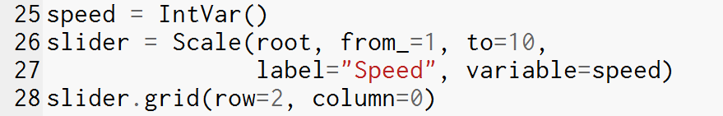

The Widgets: Scale
Allows user to input a value within a range
Notes:
The Scale is a sliding widget. The from _ and to arguments configure its range. The from_ has an underscore because from is a reserved word in Python.

Slide 10
The Widgets: Text
Allows user to edit text in a window
Displays text in the window
Notes:
This is a Text widget. Like most of the widgets, it can be instantiated with optional arguments to configure it, like height and width for this one.
The rowspan and sticky arguments are used in this call to grid().

Slide 11
Geometry Manager Options
Columns
0 1 2
0
1
2
3
Rows
Notes:
The grid method lets you do some rough arrangement. Other geometry managers can give you more fine-grained control.
The Canvas was placed in row=0, column=1.
The Text widget is spanning two rows, starting in row 2. It is also in the southeast corner of its cell.

Slide 12
The Widgets: Scale
Many widgets need a special variable (a TkVariable object) to connect to
TkVariables:
IntVar
DoubleVar
StringVar
BoolVar
Notes:
There are four classes in Tkinter for special variables. These are not widgets, but instead they work with widgets.
IntVar is one of the four Tkinter variable classes. We need one of those to give the Scale constructor its “variable” argument. Later we can get the speed with the get() method of the Tk Variables, as shown in the lower right.

Slide 13
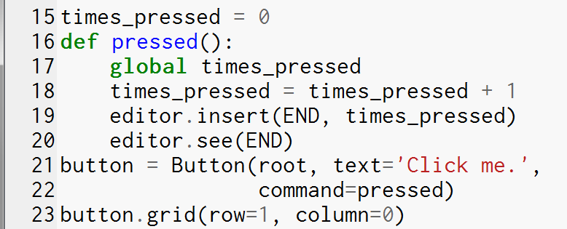
The Widgets: Button
Notes:
Buttons are connected to handlers with the command argument. Define the handler first. Then use that function name with the command argument.
This button’s handler is doing two things:
1. The handler increments the variable times_pressed. (What role is this variable playing?)
2. The handler calls two methods on the Text widget. These methods display some text and move the Text’s viewing window. END is a Tkinter constant useful for a Text widget.

Slide 14
CS Concept: Scope and Namespaces
Notes:
Scope is a fundamental CS concept. Scope is where you can get a variables value using the variable’s name.
In Python each PY file (called a module) has its own namespace that encompasses other namespaces inside the file. The module/file’s namespace is called the “global” scope while the program is running.
Each def and class statement create a nested scope inside the scope where the command is executed.
In Python the interpreter will look in the namespace of successively larger scopes for a variable when you refer to it, and it will use the first one it comes to. (Nested namespaces create a tree of namespaces!)
However, when you ASSIGN to a variable, if the variable is not in the most local scope, the interpreter will create a new variable with that name in the local namespace.
So line 18 will create a new variable times_pressed that exists only inside of the def pressed block. As soon as that block is done executing, the new variable will be garbage collected.
Declare global inside a function def if you want to assign to a variable in the global scope.

Slide 15
The Widgets: Text
Allows user to edit text in a window
Displays text in the window
Notes:
This is a Text widget. Like most of the widgets, it can be instantiated with optional arguments to configure it, like height and width for this one.
The rowspan and sticky arguments are used in this call to grid().

